Slide 1

THE NATIONAL INSTITUTE OF ENGINEERING, MYSORE
(Department of Computer Science and Engineering)
Secure and Autonomous Enterprise Multi Agent System
Team Members:
Nischitha H. L (4NI23CI064)
Omkar S. Moodvi (4NI23CI068)
Sanmitha H. (4NI23CI096)
Under the Guidance of
Mr. Gowtham R Naik
Assistant Professor, Dept of CSE

Slide 2
Table of Contents
Introduction
Abstract
Objectives
Literature Survey
Implementation
Existing system and Disadvantages
Proposed System and advantages
System requirements

Slide 3
INTRODUCTION
Modern enterprises depend on multiple software platforms such as Enterprise Resource Planning (ERP), Customer Relationship Management (CRM), Human Resource Management Systems (HRMS), cloud storage, and project management tools to manage their daily operations. These platforms help organizations store and process large amounts of data, automate routine activities, and improve communication across different departments. However, most enterprise applications operate independently, resulting in information silos and poor data integration. Employees often need to switch between multiple applications to complete a single task, which increases complexity and reduces productivity. Traditional AI assistants and chatbots provide only limited support because they mainly focus on answering queries rather than coordinating complete workflowsTo overcome these limitations, the proposed Secure and Autonomous Multi-Agent Enterprise Assistant integrates multiple specialized AI agents with Retrieval-Augmented Generation (RAG), Zero-Trust Security, Role-Based Access Control (RBAC), Explainable Artificial Intelligence (XAI), and Human-in-the-Loop validation. This integrated approach enables secure, accurate, transparent, and intelligent enterprise workflow automation while improving overall organizational efficiency.

Slide 4
ABSTRACT
The Secure and Autonomous Multi-Agent Enterprise Assistant is an AI-driven platform designed to automate enterprise workflows by integrating multiple specialized AI agents within a secure and intelligent environment. The system addresses common enterprise challenges such as information silos, repetitive tasks, inefficient collaboration, and the limited capabilities of traditional AI assistants. Unlike conventional single-agent systems, the proposed framework divides complex user requests into smaller subtasks and assigns them to dedicated agents responsible for information retrieval, analytics, workflow execution, and security verification. The system incorporates Retrieval-Augmented Generation (RAG) to retrieve information from enterprise knowledge sources and reduce AI hallucinations. Zero-Trust Security and Role-Based Access Control (RBAC) ensure that only authorized users can access sensitive enterprise resources. In addition, Explainable Artificial Intelligence (XAI) provides transparency by explaining how decisions are made, while Human-in-the-Loop validation allows experts to review and approve critical operations. By combining intelligent automation with advanced security mechanisms, the proposed system improves the accuracy, productivity, security, transparency, and scalability of enterprise workflow management.

Slide 5
OBJECTIVES
Design a secure multi-agent architecture for enterprise workflow automation.
Implement intelligent task decomposition using autonomous AI agents.
Integrate Retrieval-Augmented Generation (RAG) for accurate information retrieval.
Enforce Zero-Trust Security and Role-Based Access Control (RBAC) for secure data access.
Reduce AI hallucinations using enterprise knowledge retrieval.
Provide Explainable AI (XAI) for transparent decision-making. Enable Human-in-the-Loop validation for critical enterprise tasks.
Evaluate system performance using accuracy, security, and workflow metrics

Slide 6
LITERATURE SURVEY
SL NO | TITTLE AND YEAR OF PUBLICATION | SUMMARY | DRAWBACKS AND ACCURACY | HOW IT IS RELATED TO OUR PROJECT
1 | Large Language Models as Agents in Dynamic Multi-Agent Planning: Challenges, Directions, and Future Prospects (2026) | Explores the use of LLMs as intelligent agents for planning, decision-making, and interaction in dynamic environments | computational cost and coordination challenges. Accuracy: Not reported. | ovides the foundation for integrating LLM-based intelligent agents into our enterprise assistant.
2 | Multi-Agent AI (2026) | Explains the principles of multi-agent systems, including agent interaction, communication, and collaboration. | Drawbacks: Scalability issues and complex implementation. Accuracy: Not reported. | Provides the basic architecture required for developing our multi-agent enterprise assistant.
3 | Agents AI (2026) | Discusses different types of AI agents and their ability to solve tasks through cooperation. | Drawbacks: Reliability and integration challenges. Accuracy: Not reported. | Supports our idea of using multiple specialized agents to perform different enterprise tasks.

Slide 7
LITERATURE SURVEY
SL NO | TITTLE AND YEAR OF PUBLICATION | SUMMARY | DRAWBACKS AND ACCURACY | HOW IT IS RELATED TO OUR PROJECT
4 | A Neuro-Symbolic Multi-Agent System for Explainable and Trustworthy Decision-Making in Organizational Contexts (2026) | Combines symbolic reasoning and AI to improve explainability and decision-making in organizations. | Drawbacks: High computational overhead. Accuracy: 63.5%–83.3% across different domains. | overhead. Accuracy: 63.5%–83.3% across different domains.
5 | LLM-Based Intelligent Agents for Cybersecurity: A Tutorial and Survey of Automated Vulnerability Discovery (2026) | Reviews how LLM-based agents can automate cybersecurity tasks and vulnerability detection. | Drawbacks: Hallucination and security risks. Accuracy: Not reported. | Provides techniques that strengthen the security component of our enterprise assistant.
6 | Secure Agents AI and Multimodal Intelligence in 6G Communication Systems (2026) | Presents secure AI agents capable of processing multiple data types in next-generation communication systems | Drawbacks: Complex implementation and limited practical deployment. Accuracy: Not reported. | Contributes concepts related to secure communication and autonomous decision-making.

Slide 8
LITERATURE SURVEY
SL NO | TITTLE AND YEAR OF PUBLICATION | SUMMARY | DRAWBACKS AND ACCURACY | HOW IT IS RELATED TO OUR PROJECT
7 | From Language to Action: A Review of Large Language Models and Autonomous Agents (2026) | Reviews the evolution of LLMs into autonomous systems capable of performing real-world actions. | Drawbacks: Privacy concerns and high computational requirements. Accuracy: Not reported. | Demonstrates how autonomous agents can perform enterprise-level tasks.
8 | A Multi-Agent Approach with Verifiable and Data Sovereign Information Flows for Decentralizing Federated Distributed Energy Systems (2025) | Proposes a secure framework for data sharing and cooperation among distributed agents. | Drawbacks: Increased complexity due to privacy and security requirements. Accuracy: Not reported. | Provides ideas for secure data sharing between agents in our projec
9 | A Multi-Layered AI-Driven Cybersecurity Architecture: Integrating Entropy Analytics, Fuzzy Reasoning, Game Theory, and Multi-Agent Learning for Adaptive Threat Defense (2025) | Introduces a layered security model for detecting and responding to cyber threats. | Drawbacks: Traditional methods are ineffective against advanced attacks. Accuracy: Not reported. | Supports the cybersecurity component of our enterprise assistant.

Slide 9
LITERATURE SURVEY
SL NO | TITTLE AND YEAR OF PUBLICATION | SUMMARY | DRAWBACKS AND ACCURACY | HOW IT IS RELATED TO OUR PROJECT
10 | AI-Agent Communication Network for 6G: Vision, Architecture, and Key Technologies (2025) | Describes communication protocols and architectures for collaborative AI agents. | Drawbacks: Security and scalability issues. Accuracy: Not reported. | Provides communication models that can be applied to interactions between agents in our system.
11 | Agentic AI: Autonomous Intelligence for Complex Goal-Oriented Systems – A Survey (2025) | Provides a comprehensive overview of agentic AI and autonomous decision-making systems. | Drawbacks: Ethical concerns and safety risks. Accuracy: Not reported. | Directly supports the design and implementation of our agent-based architecture.
12 | Security of Internet of Agents and Countermeasures (2025) | Examines security threats and countermeasures in networks containing multiple intelligent agents. | Drawbacks: Trust management and authentication challenges. Accuracy: Not reported. | Provides security mechanisms that can be incorporated into our enterprise assistant.

Slide 10
LITERATURE SURVEY
SL NO | TITTLE AND YEAR OF PUBLICATION | SUMMARY | DRAWBACKS AND ACCURACY | HOW IT IS RELATED TO OUR PROJECT
13 | Finding the Optimal Security Policies for Autonomous Cyber Operations With Competitive Reinforcement Learning (2024) | Proposes Competitive Reinforcement Learning to train autonomous attacker and defender agents in a simulated cyber environment. The agents learn optimal security policies through continuous interaction | Drawbacks: Computationally expensive, limited real-world applicability, neural-network forgetting, and evaluation using only two competing agents. Accuracy: Not reported | Demonstrates autonomous agents, policy learning, observations, actions, rewards, and iterative improvement. These concepts support the intelligent behavior of our multi-agent system.
14 | A Comprehensive Survey: Evaluating the Efficiency of Artificial Intelligence and Machine Learning Techniques on Cyber Security Solutions (2024) | Presents a comprehensive survey of AI, ML, DL, RL, and ChatGPT-based techniques for cybersecurity, including malware detection, intrusion detection, phishing detection, fraud detection, vulnerability analysis, and zero-day attack detection | Drawbacks: Data quality issues, high computational requirements, false positives, adversarial attacks, model bias, and the lack of up-to-date datasets. Accuracy: Not reported. | Strongly supports the cybersecurity intelligence layer of our project by providing techniques for threat detection, adaptive response, and autonomous security management.
15 | Enhancing Mobile Enterprise Security: A Blockchain and Agent Paradigm-Based Approach for Continuous Protection and Rapid Adaptation (2024) | Proposes the MAM+ architecture, which combines blockchain and mobile agents to continuously detect, analyze, and respond to security threats in enterprise environments. | Drawbacks: Relies on signature-based attack detection, assumes secure agent migration, blockchain increases architectural complexity, and some attacks still require human intervention. Accuracy: Not reported. | Highly relevant because it demonstrates how autonomous agents can cooperate, communicate, and distribute responsibilities while using blockchain to improve enterprise security.

Slide 11
IMPLEMENTATION
SYSTEM ARCHITECTURE
The system consists of a React.js frontend connected to a FastAPI backend. A workflow orchestrator receives user requests and coordinates specialized AI agents such as RAG, Security, Analytics, Workflow, and Validation agents. These agents access the enterprise database and vector database to retrieve and process information. LLM, RAG, XAI, and RBAC ensure accurate, secure, and explainable responses, with Human-in-the-Loop validation for critical tasks.
Flow: User → React.js → FastAPI → Orchestrator → AI Agents → Databases → LLM/RAG/XAI → Final Response

Slide 12
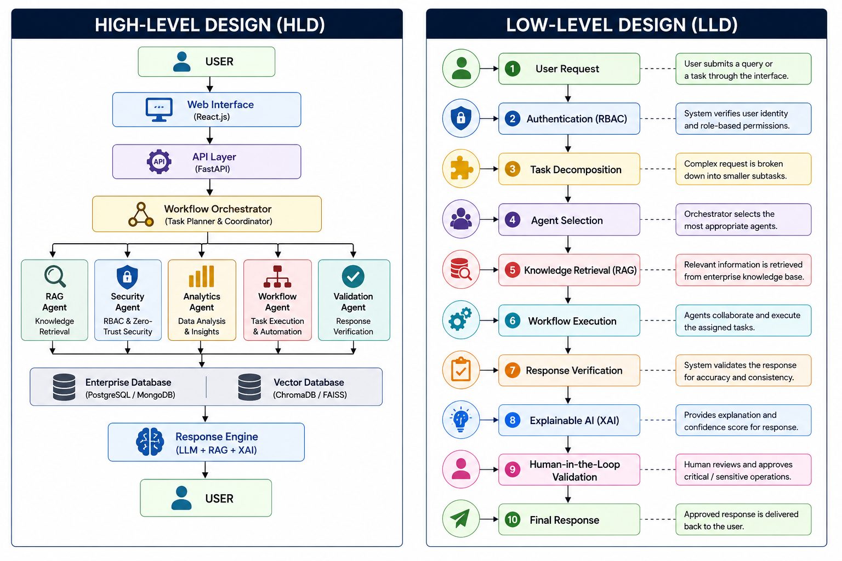
IMPLEMENTATION
SYSTEM ARCHITECTURE

Slide 13
EXISTING SYSTEM AND DISADVANTAGES
Most organizations use enterprise applications such as ERP, CRM, HRMS, Microsoft Copilot, Google Gemini for Workspace, ServiceNow AI, Jira Automation, and traditional AI chatbots to automate routine business operations. These systems support tasks such as information retrieval, report generation, query handling, and workflow management. However, they operate independently and require manual coordination between different applications and departments. Most existing AI assistants also rely on a single-agent architecture, which limits their ability to manage complex enterprise workflows.
Disadvantages of the Existing System:
Single-agent architecture limits collaboration and task management.
Unable to perform autonomous multi-step workflows, resulting in increased manual effort.
High AI hallucination rates may generate inaccurate information.
Weak access control increases the risk of unauthorized access to sensitive data.
Limited explainability and auditability reduce transparency in decision-making.
Poor scalability affects performance in complex enterprise environments.

Slide 14
EXISTING SYSTEM AND DISADVANTAGES
Most organizations use enterprise applications such as ERP, CRM, HRMS, Microsoft Copilot, Google Gemini for Workspace, ServiceNow AI, Jira Automation, and traditional AI chatbots to automate routine business operations. These systems support tasks such as information retrieval, report generation, query handling, and workflow management. However, they operate independently and require manual coordination between different applications and departments. Most existing AI assistants also rely on a single-agent architecture, which limits their ability to manage complex enterprise workflows.
Disadvantages of the Existing System:
Single-agent architecture limits collaboration and task management.
Unable to perform autonomous multi-step workflows, resulting in increased manual effort.
High AI hallucination rates may generate inaccurate information.
Weak access control increases the risk of unauthorized access to sensitive data.
Limited explainability and auditability reduce transparency in decision-making.
Poor scalability affects performance in complex enterprise environments.

Slide 15
PROPOSED SYSTEM AND ADVANTAGES
The proposed Secure and Autonomous Multi-Agent Enterprise Assistant introduces a framework in which multiple specialized AI agents work together to automate enterprise workflows. The system decomposes complex user requests into smaller subtasks and coordinates agents for information retrieval, analytics, workflow automation, and security verification. It integrates Retrieval-Augmented Generation (RAG), Zero-Trust Security, and Role-Based Access Control (RBAC) to ensure accurate responses and secure access to enterprise data. In addition, Explainable AI (XAI) and Human-in-the-Loop validation improve transparency and provide approval for critical operations.
Advantages of the Proposed System:
Intelligent multi-agent collaboration improves coordination between different AI agents.
Dynamic task planning and workflow execution reduce manual intervention.
Reduced AI hallucinations through RAG improve response accuracy.
Strong Zero-Trust Security protects sensitive enterprise data.
Explainable AI with confidence scores increases transparency and user trust.
Human-in-the-Loop validation improves the reliability of critical operations.
Scalable enterprise architecture supports complex business environments.
Faster and more accurate workflow automation improves overall productivity.

Slide 16
SYSTEM REQUIREMENTS
SOFTWARE REQUIREMENTS
Requirement | Specification
Operating System | Windows 11 / Ubuntu 22.04
Programming Language | Python 3.11
Frontend | React.js
Backend | FastAPI
Database | PostgreSQL / MongoDB
Vector Database | ChromaDB / FAISS
Large Language Model (LLM) | Llama 3 / Mistral / GPT
AI Framework | LangChain
Multi-Agent Framework | LangGraph / CrewAI / AutoGen

Slide 17
SYSTEM REQUIREMENTS
HARWARE REQUIREMENTS
Requirement | Specification
Processor | Intel Core i5/i7 (or equivalent)
RAM | 16 GB (Minimum 8 GB)
Storage | 512 GB SSD
Internet Connection | Required
GPU | NVIDIA GPU (Optional for local LLM execution)

Slide 18
CONCLUSION
The proposed Secure and Autonomous Multi-Agent Enterprise Assistant provides an intelligent and secure approach to enterprise workflow automation by integrating multiple specialized AI agents within a single platform. The system combines Retrieval-Augmented Generation (RAG), Zero-Trust Security, Role-Based Access Control (RBAC), Explainable AI (XAI), and Human-in-the-Loop validation to improve response accuracy, strengthen security, and increase transparency in decision-making. By reducing AI hallucinations and enabling efficient collaboration among AI agents, the proposed system overcomes the limitations of traditional enterprise assistants. Therefore, this project offers a scalable, reliable, and efficient solution for modern enterprise environments and contributes to the future development of secure AI-driven workflow management.

